Slide 1
Presentation on “GSOC”
Under the Guidance of:
MR. P.K Mishra
(Asst. Professor)
Dept. of CSE
Submitted By:
Siddharth Verma(1612810099)
Upasana Kumari(1612810096)
Dept. of CSE
DR. A.P.J. ABDUL KALAM TECHNICAL UNIVERSITY, LUCKNOW
March, 2020

Slide 2
Contents
S.No. | Title
1. | Abstract
2. | Literature Review
3. | Problem Description Existing Problem Proposed Solution
4. | Overall Block Diagram
5. | ER Diagram
6. | Flow Chart
7. | Use Case Diagram
8. | Data Flow Diagram [DFD] Level 1
9. | PERT Chart
10. | Implementation
11. | Performance Analysis
12. | Outputs
13. | Conclusion

Slide 3
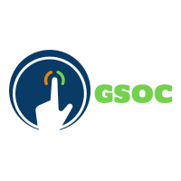
GESTURE | SECURITIES OPERABLES CONTROLS
LETS START THE PRESENTATION OFFICIALLY

Slide 4
ABSTRACT

Slide 5
ABSTRACT
Developed as a cross platform desktop application, Gesture Securities Operable Controls [GSOC] is a application which is implemented with electron framework with google sheets as database. The project’s main aim is to provide a desktop application which makes use of the webcam to provide security with the help of face detection, media player gesture control and mouse control.
The project stack is build on electron framework which is a flavor of javascript which implements frontend with javascript, Node.js, bootstrap. The stack business logic is created on python and database is google sheet with the help of google apis.

Slide 6
LITERATURE
REVIEW

Slide 7
LITERATURE REVIEW
The Need
01
The system with web cam can be used for gesture recognition. Previous model lacked accuracy. But with trained dataset the results are better.
Previous Model
02
The previous model made use of openCv but the current implementation makes use of tensorflow model to provide classes to predict result.
The Outcome
03
Implementing the application will make use of the potential of a system providing with very well serving utilities.

Slide 8
Problem Description

Slide 9
Existing
Problem
Proposed
Solution
1. Lack use of webcam
2. Use of ML with system utilities
3. Lack of Desktop Application availability to Provide the requirements.
4. Cross Platform Application
5. Accuracy and Preciseness
1. Use Webcam to its fullest
2. Use of ML
3. A desktop application to deal with the Necessity
4. Use Electron framework to create a cross platform application
5. Provide better result with trained data

Slide 10
Block Diagram

Slide 11
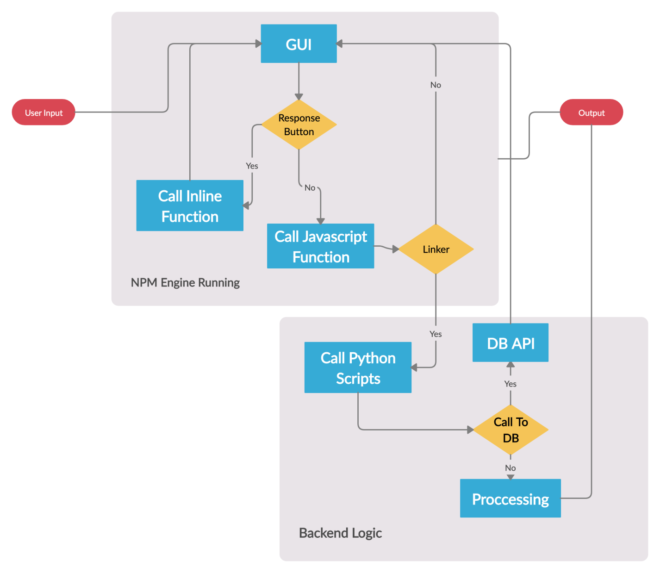

Slide 12
ER Diagram

Slide 13
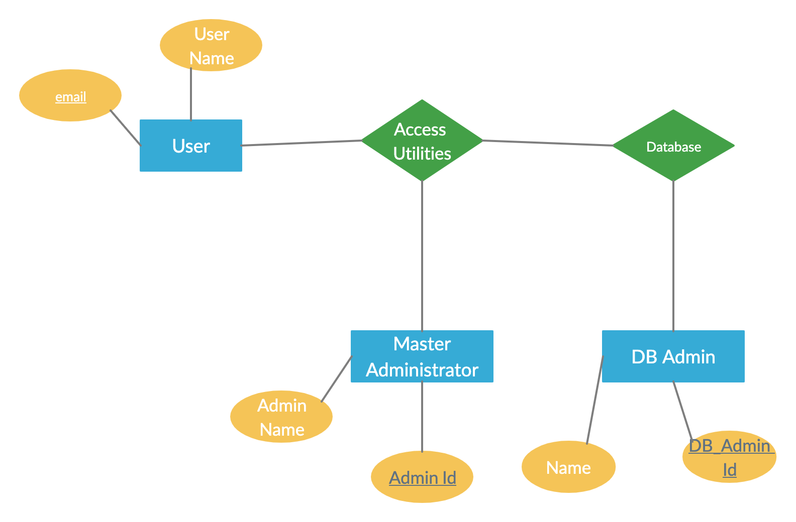

Slide 14
Flow Chart

Slide 15
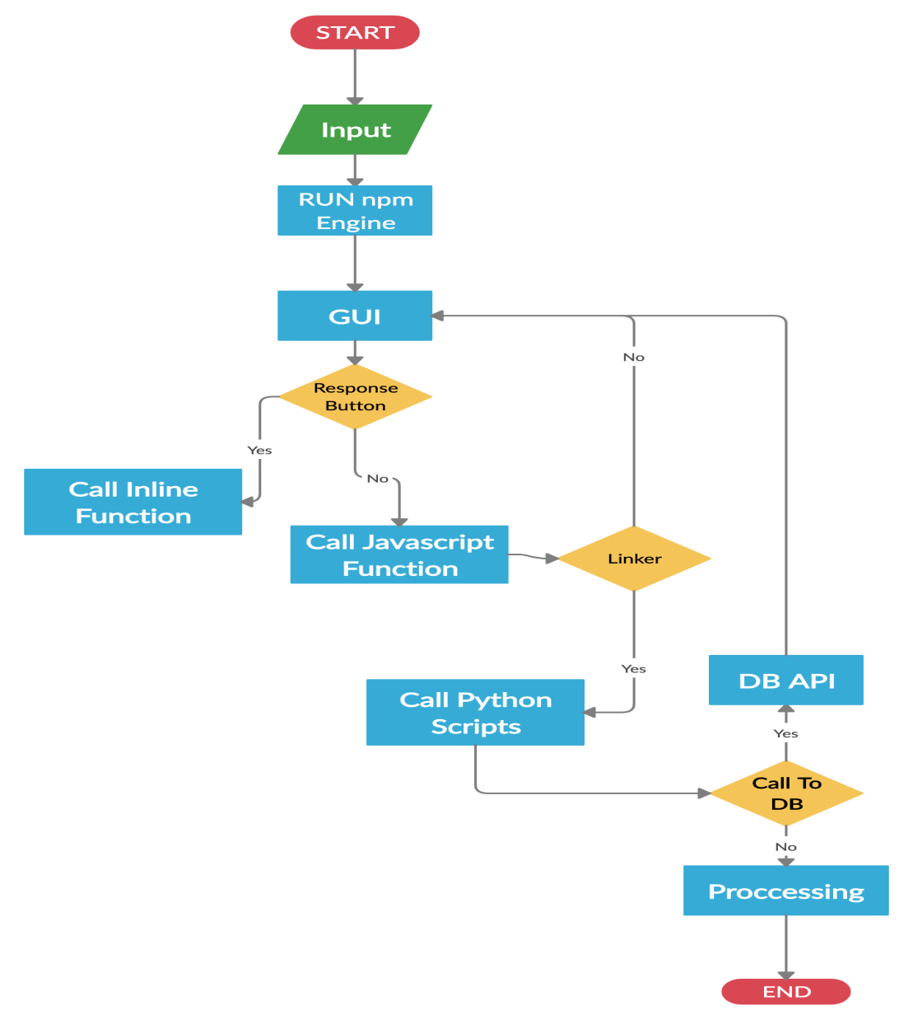

Slide 16
Use Case Diagram

Slide 17
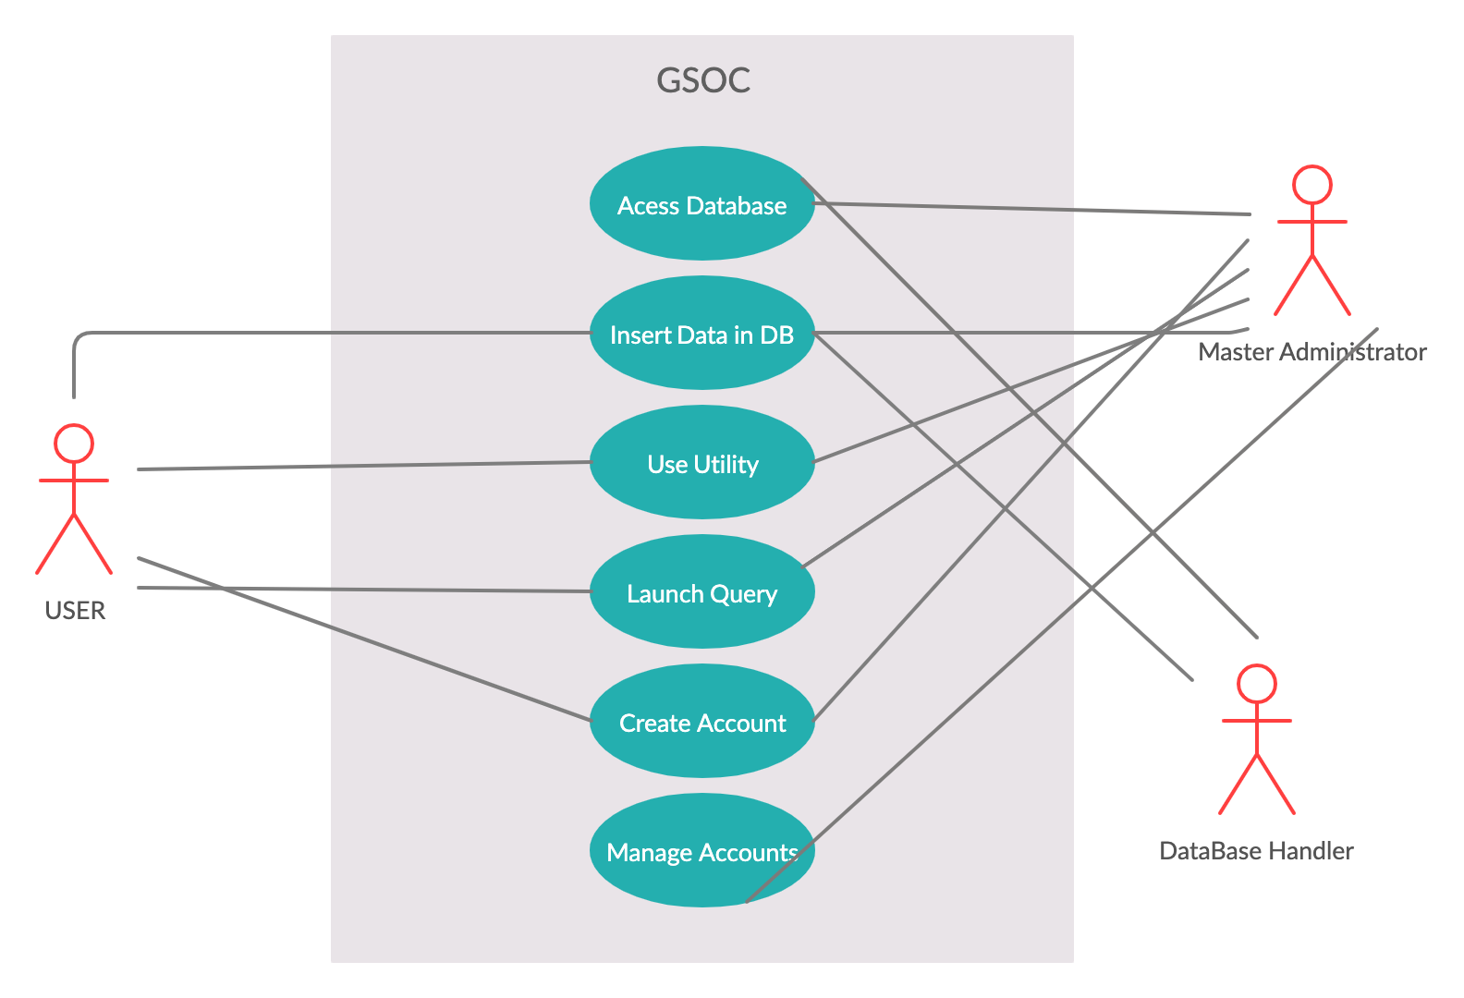

Slide 18
DATA FLOW DIAGRAM

Slide 19
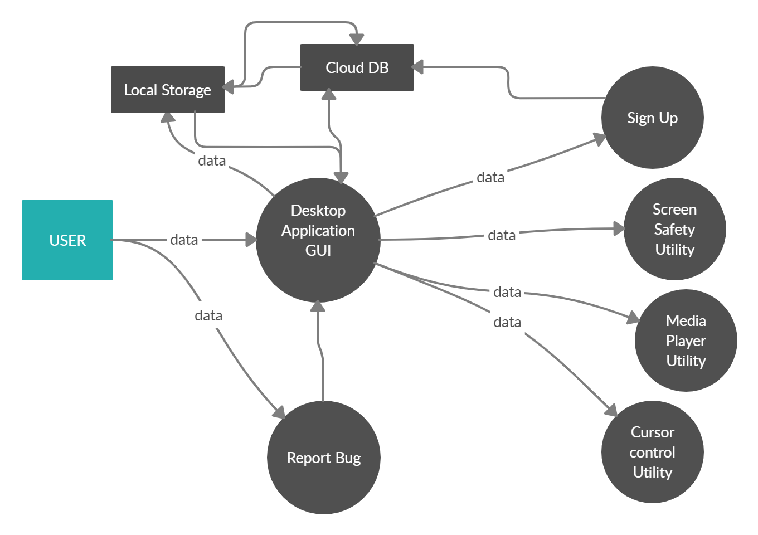

Slide 20
PERT CHART

Slide 21
Create
GUI
Create
linkers
DB creation
Test backend
Create
Python
scripts
Create
linkers
DB
connection
Test
application

Slide 22
Implementation
Installing Requirements
For the project the following requirement where installed
Python 3
Anaconda
Tensorflow
Node-js
Npm python-shell
Electron
Pip install gsheet oauthclient
Google Api

Slide 23
Implementation
Creating GUI
The GUI for the cross platform Desktop is implemented on node.js, javascript, bootstrap on top. This technology is help to create a GUI which is platform and environment independent that is it can also be run as a web application with minor changes.
Creating Python
Scripts
The Python scripts that are created are build for different purposes like gesture recognition, user data upload to DB.

Slide 24
Implementation
Creating DB
Using google sheet as DB. Creating a project at google repository, creating a user and generating credentials for accessing the google api
Creating linkers using javascript to bind the GUI with the python scripts
Linkers
Running npm engine
Run the npm engine to create the desktop application.
Based on the user input and processing we get the output.
Output

Slide 25
PERFORMANCE
ANALYSIS

Slide 26
Performance Analysis
60%
50%
Of total test cases run
Successfully ran on all platform except (kali, parrot)
Of accuracy received on the gesture recognition model.
80%
40%
Of test cases failed were due to database connection and background noise cancellation.
Of Application crashed were reached at the threshold of 182 rps.

Slide 27
OUTPUTS

Slide 28
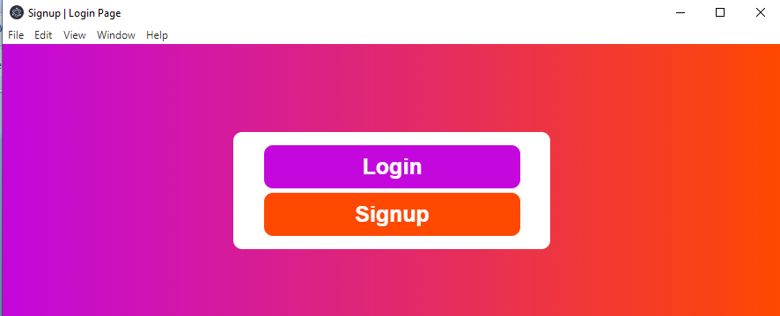
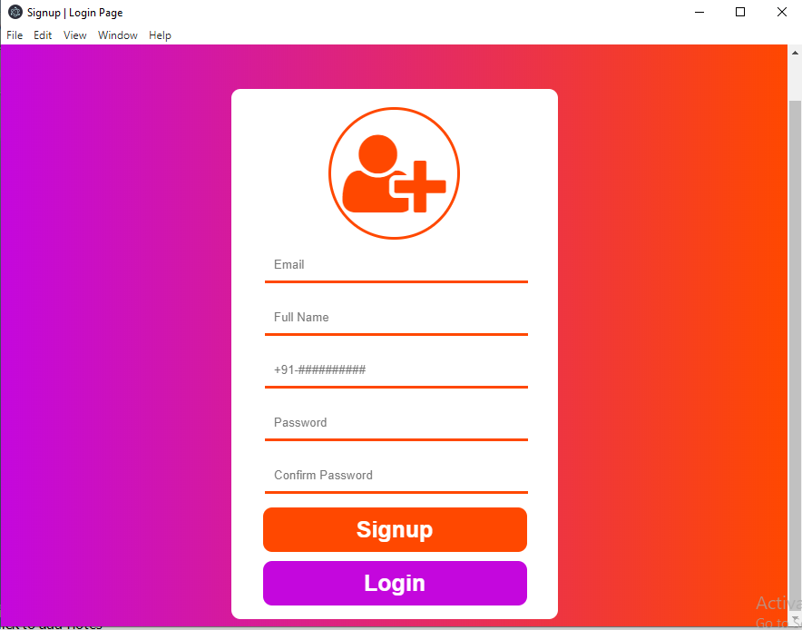
SIGN UP PAGE OF GSOC

Slide 29
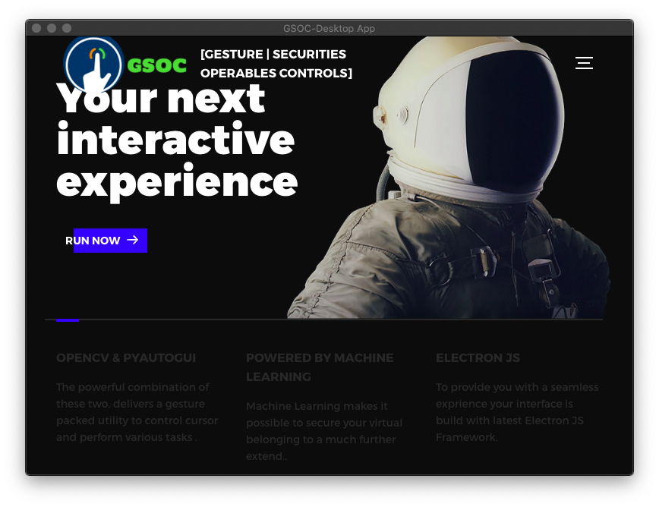
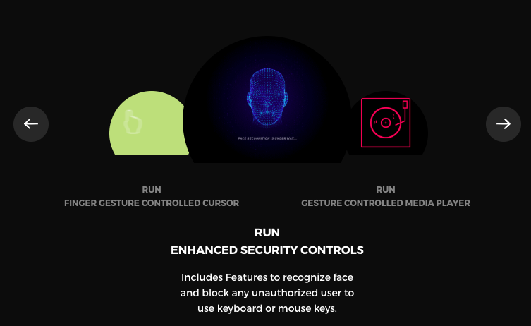
MAIN PAGE OF GUI
PROVIDED UTILITIES

Slide 30
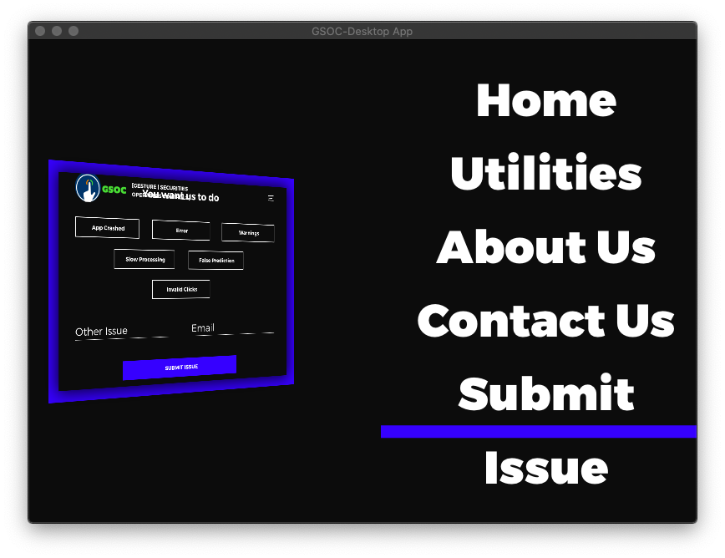
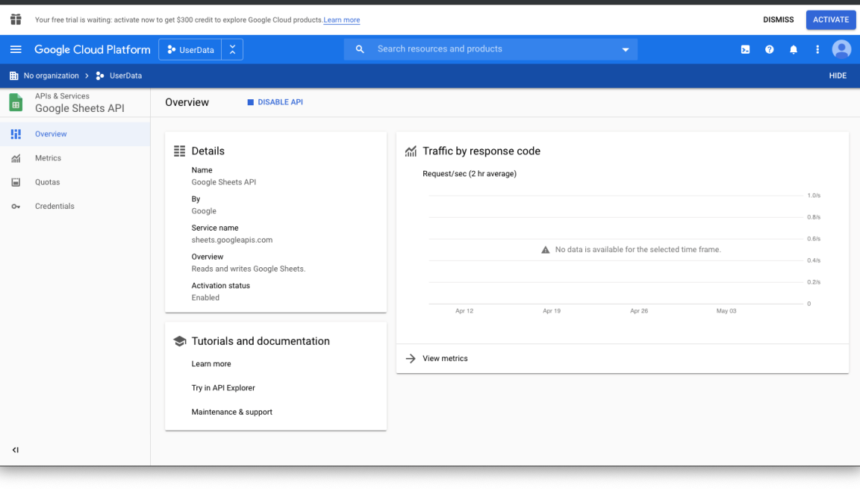
DYNAMIC GUI DISPLAY
API REQUEST PORTAL

Slide 31
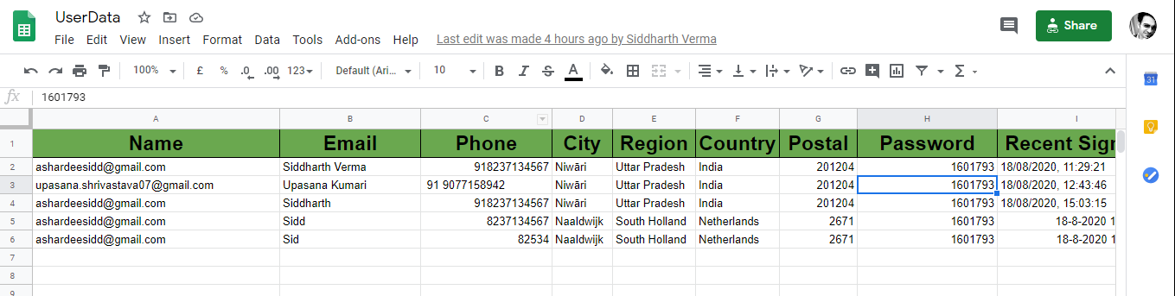
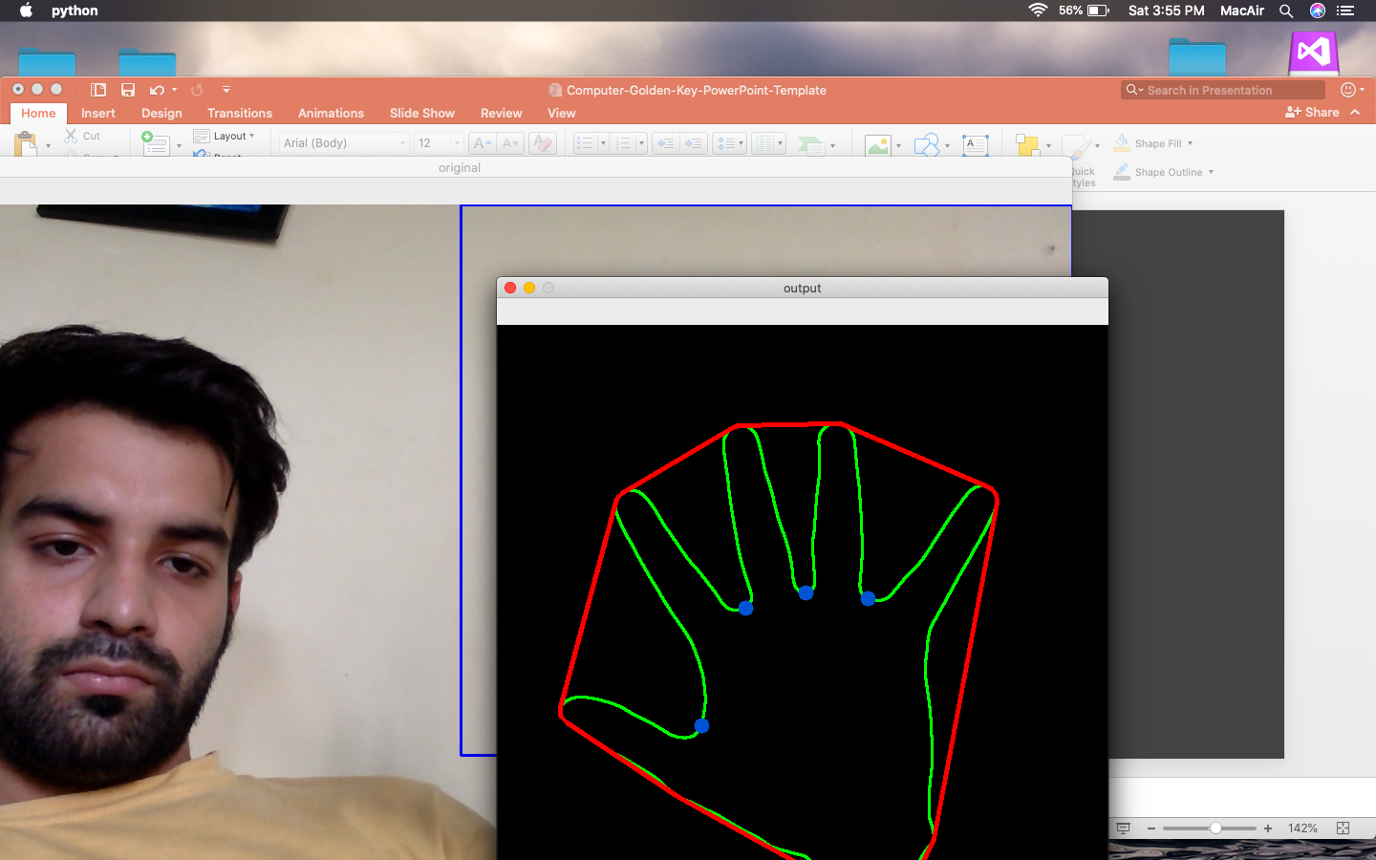
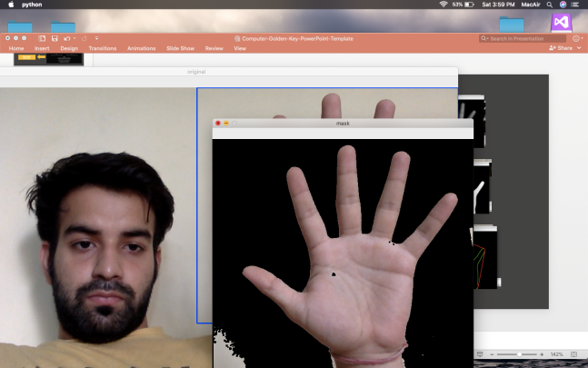
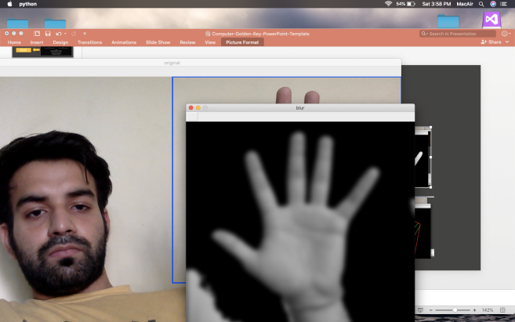
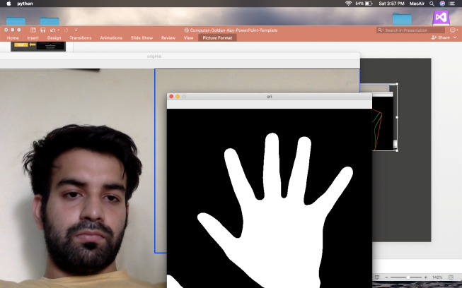
USER DB
Process

Slide 32
CONCLUSION

Slide 33
CONCLUSION
The Need
01
The system with web cam can be used for gesture recognition. With more advancement the utility of old system can be brought back into use.
More Ease
02
With the implementation, ppt, slideshow, media player can be control by gestures.
03
The accuracy of the application can be made better by more training.

Slide 34
Thank you

